Slide 1

JAVA AGENDA FOR THE SESSION
JAVA8 FEATURES
JDBC INTRODUCTION

Slide 2

JAVA LEARNING ROADMAP
JAVA
JAVA
Lambda Expressions
Method References
Functional Interfaces
Stream API
Default Methods
Collectors Class
Optional Class
JDBC Introduction
Advantages of JDBC
JDBC Architecture
JDBC API
Sample JDBC App

Slide 3
LAMBDA EXPRESSION
Lambda expression is a new and important feature of Java which was included in Java SE 8.
It provides a clear and concise way to represent one method interface using an expression.
Java lambda expression is treated as a function, so compiler does not create .class file.
Java lambda expression is consisted of three components.

Slide 4
METHOD REFERENCES
Method reference is used to refer method of functional interface.
It is compact and easy form of lambda expression.
Each time when you are using lambda expression to just referring a method, you can replace your lambda expression with method reference.

Slide 5
FUNCTIONAL INTERFACES
An Interface that contains exactly one abstract method is known as functional interface.
It can have any number of default, static methods but can contain only one abstract method.
It can also declare methods of object class.
Functional Interface is also known as Single Abstract Method Interfaces or SAM Interfaces.

Slide 6
STREAM API
Stream does not store elements. It simply conveys elements from a source such as a data structure, an array, or an I/O channel, through a pipeline of computational operations.
Stream is functional in nature. Operations performed on a stream does not modify it's source.
Ex:filtering a Stream obtained from a collection produces a new Stream without the filtered elements, rather than removing elements from the source collection.

Slide 7
DEFAULT METHODS
java provides a facility to create default methods inside the interface.
Methods which are defined inside the interface and tagged with default are known as default methods.
These methods are non-abstract methods.
You can also define static methods inside the interface.
Static methods are used to define utility methods.

Slide 8
COLLECTORS CLASS
Collectors is a final class that extends Object class.
It provides reduction operations, such as accumulating elements into collections, summarizing elements according to various criteria, etc.

Slide 9
OPTIONAL CLASS
Java introduced a new class Optional in jdk8.
It is a public final class and used to deal with NullPointer Exception in Java application.
You must import java.util package to use this class.
It provides methods which are used to check the presence of value for particular variable.

Slide 10
DATE & TIME
Initial Date class introduced in Java 1.0 was not a true representation of the date but a point in time with milliseconds as precision.
Calendar API introduced as a replacement was poorly designed and lead to confusion in day to day use.
The Date and Calendar classes are not thread-safe.
None of the instance methods are synchronized, and none of the instance fields are volatile, even get method can cause an instance of these classes as Mutable.
A developer needs to ensure thread safety in case they are using these classes.

Slide 11
DATE TIME API
Java has introduced a new Date and Time API since Java 8. The java.time package contains Java 8 Date and Time classes.
java.time.LocalDate class
java.time.LocalTime class
java.time.LocalDateTime class
java.time.ZonedDateTime class
java.time.ZoneId class
java.time.Period class
java.time.Duration class

Slide 12
LOCALDATE
Java LocalDate class is an immutable class that represents Date with a default format of yyyy-mm-dd.
It inherits Object class and implements the ChronoLocalDate interface.
It is useful for representing a date without a time.
It can be used to represent a date only information such as a birth date or wedding date.

Slide 13
LOCALTIME
java.time.LocalTime class represents time, which is viewed as hour-minute-second.
This class is immutable and also thread-safe.
There are various methods under java.time.LocalTime class.
Java LocalTime class is an immutable class. It inherits Object class and implements the Comparable interface.
Ex: movie times, or the opening and closing times.

Slide 14
LOCALDATETIME
The LocalDateTime class represents the date-time,often viewed as year-month-day-hour-minute-second and has got no representation of time-zone.
The “local” part of the name refers to the local time-line. LocalDateTime class supports nanosecond precision.
For example, the value “2nd October 2007 at 13:45.30.123456789” can be stored in a LocalDateTime.

Slide 15
JDBC
JDBC is a java based data access technology from Sun Microsystems.
JDBC is an open specification that contains rules and guidelines.
The process of interacting with the database from Java Applications is called JDBC. JDBC is a Java API which enables java programs to execute SQL statements.

Slide 16
ADVANTAGES OF JDBC
Any kind of java program can communicate with any RDBMS implementation (any vendor’s DBMS product) in a standard manner using JDBC.
RDBMS implantation means any vendors DBMS product means Microsoft’s SQL Server, Oracle’s MySQL, IBM’s DB2.
To communicate with any kind of RDBMS the standard procedure is the same means the procedure of connectivity is the same.

Slide 17
ADVANTAGES OF JDBC
JDBC helps the programmers to write java applications that manage these three programming activities :
It helps us to connect to a data source, like a database.
It helps us in sending queries and updating statements to the database, and
Retrieving and processing the results received from the database in terms of answering your query.

Slide 18
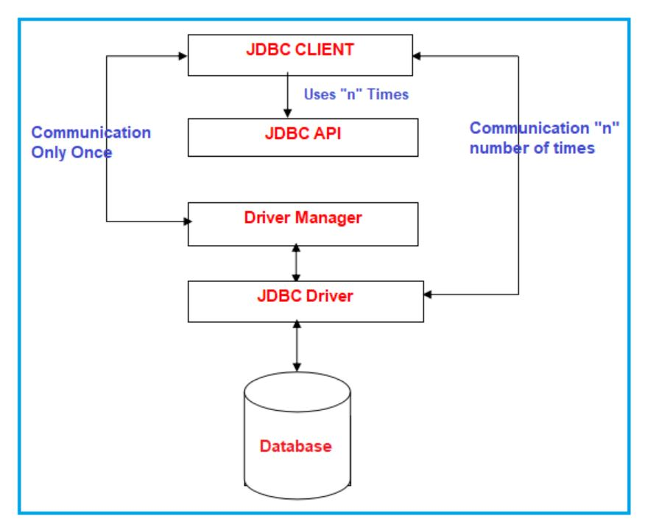
JDBC ARCHITECTURE

Slide 19
JDBC API
API (Application Programming Interface) is nothing but a collection of library methods. Library classes and interfaces contain library methods and these library classes and interfaces are present inside some predefined packages.
Java.sql: It is used for basic operations of the database.
Javax.sql: Provides the API for server-side data source access and processing from the Java programming language i.e., Connection pooling.

Slide 20
STEPS TO CREATE JDBC APP
Step1: Register JDBC driver with Driver Manager service.
Step2: Establish connection with Database software.
Step3: Create JDBC Statement Object.
Step4: Send and execute query in Database Software.
Step5: Gather results and process the results.
Step6: Close JDBC Objects.
Step7: Take care of Exception Handling.
Step8: Perform Transaction Management(if necessary).

